Slide 1
Chapter 4: Intermediate SQL

Slide 2
Chapter 4: Intermediate SQL
Join Expressions
Views
Transactions
Integrity Constraints
SQL Data Types and Schemas
Authorization
Notes:
1

Slide 3
Joined Relations
Join operations take two relations and return as a result another relation.
A join operation is a Cartesian product which requires that tuples in the two relations match (under some condition). It also specifies the attributes that are present in the result of the join
The join operations are typically used as subquery expressions in the from clause
select ……… from [join tables using joined operations] where ……….

Slide 4
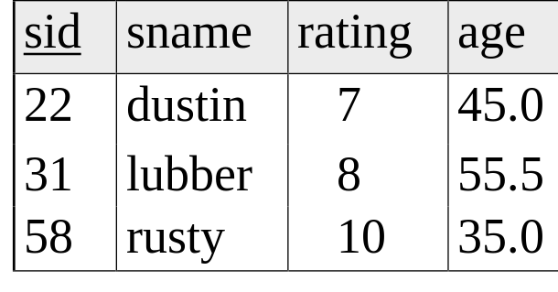
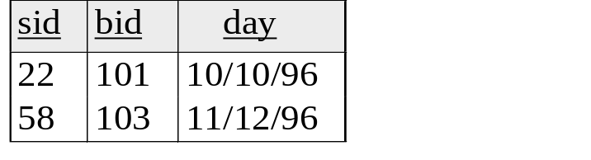
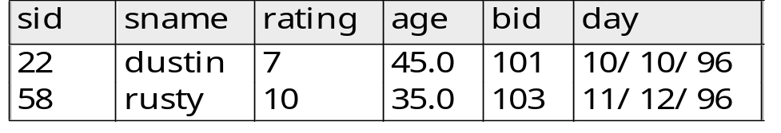
Natural Join Example
From Relational Algebra
Reserves (R1)
Sailors(S1)
Need to find related information between two tables? Merge them first.
Use natural join: merge based on values in common columns
Natural Join Notation: R1 S1,
Result of R1 S1,

Slide 5
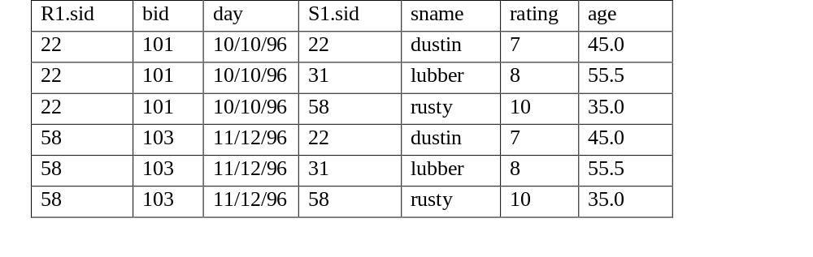
How does it work?
Reserves (R1)
Sailors(S1)
Equivalent relational expression for
R1 S1,
∏ R1.sid, bid, sname, rating, age (σ _{R1.sid = S1.sid} (R1 x S1))

Slide 6
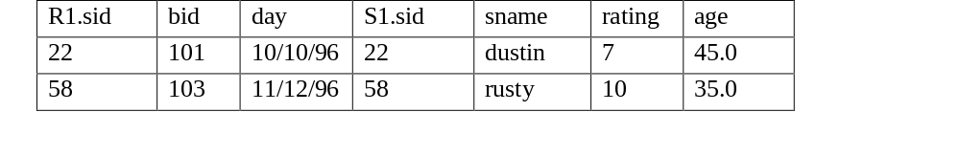
How does it work?
Reserves (R1)
Sailors(S1)
Equivalent relational expression for
R1 S1,
∏ R1.sid, bid, sname, rating, age (σ _{R1.sid = S1.sid} (R1 x S1))
Final output

Slide 7
Natural Join Example
Reserves (R1)
Sailors(S1)
Result of R1 S1, (Now you know how we get the result)

Slide 8
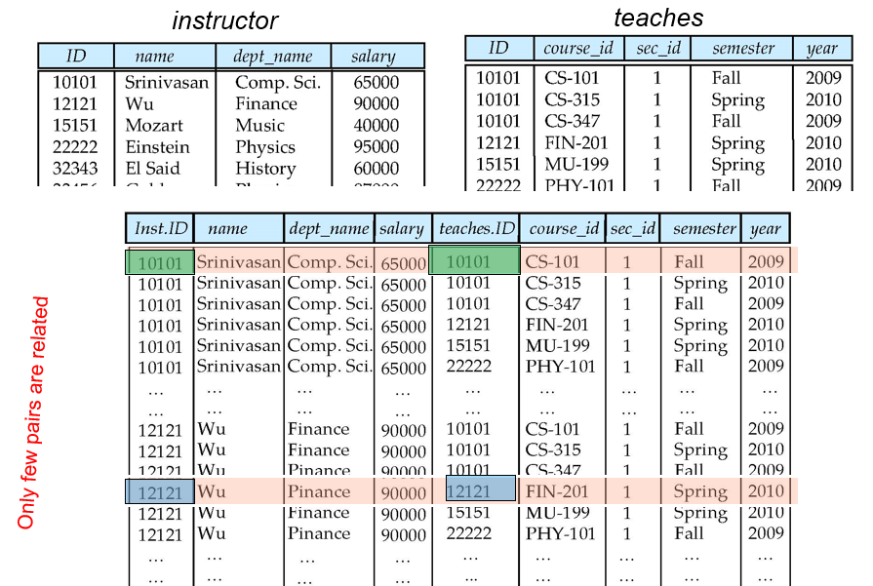
Natural Join
Find the names instructors and course ID of all courses they thought.
select name, course_id from instructor, teaches
where instructor.ID = teaches.ID

Slide 9
Natural Join
Find the names instructors and course ID of all courses they thought.
select name, course_id
from instructor, teaches
where instructor.ID = teaches.ID
Equivalent using natural join: ( only common column Is instructor IDs)
select name, course_id
from instructor natural join teaches

Slide 10
Natural Join
List names of the instructors along with the title of the courses they teaches
Select name, title
from instructor natural join teaches, course
where teaches.course_id = course.course_id
Attributes of instructors natural join teaches – ID Is common attr.
( ID, name, dept_name, salary, course_id, sec_id)
Attributes of course table-
( course_id, title, dept_name, credits)
Equivalent?
Select name, title
from instructor natural join teaches natural join course
NO, second join will be on course_id and dept_name, so,
an instructor from CS teaching course of EE won’t come in the output
Select name, title
from instructor natural join teaches join course using (course_id)

Slide 11


Join operations – Example
Relation course
Relation prereq
Observe that
prereq information is missing for CS-315 and
course information is missing for CS-437

Slide 12

Inner Join
course inner join prereq on
course.course_id = prereq.course_id
What is the difference between the above, and a natural join?
Natural Join keeps only one copy of common columns
course natural join prereq
Use inner join when no common attributes but values of two attributes are related

Slide 13
Outer Join
An extension of the join operation that avoids loss of information.
Computes the join and then adds tuples from one relation that does not match tuples in the other relation to the result of the join.
Uses null values.

Slide 14

Left Outer Join
  course natural left outer join prereq

Slide 15

Right Outer Join
course natural right outer join prereq

Slide 16

Full Outer Join
course natural full outer join prereq
Try to run following queries:
1. select * from instructor left outer join teaches on instructor.id=teaches.id
2. select * from instructor natural left outer join teaches;

Slide 17
Few more examples
Run following example queries and observe the results:
1. select * from instructor left outer join teaches on instructor.id=teaches.id
2. select * from instructor natural left outer join teaches;
---------------------------------------
1. select * from instructor NATURAL INNER JOIN department
2. select * from instructor INNER JOIN department on instructor.dept_name = department.dept_name
3. select * from instructor INNER JOIN department USING(dept_name)

Slide 18

Summary- Joining Relations
Join operations take two relations and return as a result another relation.
These additional operations are typically used as subquery expressions in the from clause
Join condition – defines which tuples in the two relations match, and what attributes are present in the result of the join.
Join type – defines how tuples in each relation that do not match any tuple in the other relation (based on the join condition) are treated.

Slide 19
Views
In some cases, it is not desirable for all users to see the entire logical model (that is, all the actual relations stored in the database.)
Consider a person who needs to know an instructors name and department, but not the salary. This person should see a relation described, in SQL, by
select ID, name, dept_name
from instructor
A view provides a mechanism to hide certain data from the view of certain users.
Any relation that is not of the conceptual model but is made visible to a user as a “virtual relation” is called a view.

Slide 20
View Definition
A view is defined using the create view statement which has the form
create view v as < query expression >
where <query expression> is any legal SQL expression. The view name is represented by v.
Once a view is defined, the view name can be used to refer to the virtual relation that the view generates.
View definition is not the same as creating a new relation by evaluating the query expression
  Rather, a view definition causes the saving of an expression; the expression is substituted into queries using the view.

Slide 21
Example Views
A view of instructors without their salary
create view faculty as
select ID, name, dept_name
from instructor
Find all instructors in the Biology department
select name
from faculty
where dept_name = ‘Biology’
Create a view of department salary totals
create view departments_total_salary(dept_name, total_salary) as
select dept_name, sum (salary)
from instructor
group by dept_name;
Notes:
*Use view to hide some columns from specific users to create security/ privacy
* You can store a query as a view instead of rewriting it again

Slide 22
Views Defined Using Other Views
create view physics_fall_2009 as
select course.course_id, sec_id, building, room_number
from course, section
where course.course_id = section.course_id
and course.dept_name = ’Physics’
and section.semester = ’Fall’
and section.year = ’2009’;
create view physics_fall_2009_watson as
select course_id, room_number
from physics_fall_2009
where building= ’Watson’;
Notes:
* You can you a view to create another view, to show a limited amount of information from the first view // it’s a nested view

Slide 23
Views Defined Using Other Views
One view may be used in the expression defining another view
A view relation v₁ is said to depend directly on a view relation v₂ if v₂ is used in the expression defining v₁
A view relation v₁ is said to depend on view relation v₂ if either v₁ depends directly to v₂ or there is a path of dependencies from v₁ to v₂ (v2 <-- one or multiple views <--v1)

Slide 24
View Expansion
Expand use of a view in a query/another view
create view physics_fall_2009_watson as
(select course_id, room_number
from (select course.course_id, building, room_number
from course, section
where course.course_id = section.course_id
and course.dept_name = ’Physics’
and section.semester = ’Fall’
and section.year = ’2009’)
where building= ’Watson’;

Slide 25
View Expansion
A way to define the meaning of views defined in terms of other views.
Let view v₁ be defined by an expression e₁ that may itself contain uses of view relations.
View expansion of an expression repeats the following replacement step:
repeat
Find any view relation v_{i} in e₁
Replace the view relation v_{i} by the expression defining v_{i}
until no more view relations are present in e₁
As long as the view definitions are not recursive, this loop will terminate

Slide 26
Update of a View
Insert, delete , update reflected on both views and original tables
Add a new tuple to faculty view which we defined earlier
insert into faculty values (’30765’, ’Green’, ’Music’);
This insertion must be represented by the insertion of the tuple
(’30765’, ’Green’, ’Music’, null)
into the instructor relation
Notes:
The actually query will be:
insert into instructor values (‘30765’, ‘Green’, ‘Music’, null);
*update and delete will also have to be converted // this conversion is done automatically by the DBMS

Slide 27
Some Updates cannot be Translated Uniquely
create view instructor_info as
select ID, name, building
from instructor, department
where instructor.dept_name= department.dept_name;
insert into instructor_info values (’69987’, ’White’, ’Taylor’);
    which department, if multiple departments in Taylor?
    what if no department is in Taylor?
Restrictions: Most SQL implementations allow updates only on simple views
  The from clause has only one database relation.
  The select clause contains only attribute names of the relation, and does not have any expressions, aggregates, or distinct specification.
  Any attribute not listed in the select clause can be set to null
  The query does not have a group by or having clause.
Notes:
Because there are two tables used to create this view, there is ambiguity as to where the information for the update should be stored
Problems: department table’s primary key is dept_name and it can’t be null // this query can never be executed because the underlying table doesn’t allow a null value for dept_name
* Use the restrictions to avoid this problem

Slide 28
And Some Not at All
create view history_instructors as
select *
from instructor
where dept_name= ’History’;
What happens if we insert (’25566’, ’Brown’, ’Biology’, 100000) into history_instructors?
Will be inserted in instructor table but not in this view
Notes:
*The view created in this example will not change as the view only show records from the history department; although the instructor table will be updated

Slide 29
Materialized Views
Materializing a view: create a physical table containing all the tuples in the result of the query defining the view
If relations used in the query are updated, the materialized view result becomes out of date
  Need to maintain the view, by updating the view whenever the underlying relations are updated.
Notes:
*After you create a view it retrieves the records from the underlying tables, it (the view) will not update if the underlying tables are updated

Slide 30
Integrity Constraints
Integrity constraints guard against accidental damage to the database, by ensuring that authorized changes to the database do not result in a loss of data consistency.
  A checking account must have a balance greater than $10,000.00
  A salary of a bank employee must be at least $4.00 an hour
  A customer must have a (non-null) phone number
Notes:
*Many of these things have been previously covered

Slide 31
Integrity Constraints on a Single Relation
not null
primary key
unique
check (P), where P is a predicate
Notes:
not null – collumn cannot accept a null value
Primary key- allows you to distinctly recognize an element in a given table; must be unique, can be a set of attributes not just one
unique- entries cannot be the same as any other entries, could be null; could be a canidite key
Check (P)- to check means to ensure a given value (P) meets certain constraints

Slide 32
Not Null and Unique Constraints
not null
  Declare name and budget to be not null
name varchar(20) not null
budget numeric(12,2) not null
unique ( A₁, A₂, …, A_{m})
  The unique specification states that the attributes A1, A2, … Am
  form a candidate key.
  Candidate keys are permitted to be null (in contrast to primary keys).

Slide 33
The check clause
check (P)
where P is a predicate
Example: ensure that semester is one of fall, winter, spring or summer:
create table section (
course_id varchar (8),
sec_id varchar (8),
semester varchar (6),
year numeric (4,0),
building varchar (15),
room_number varchar (7),
time slot id varchar (4),
primary key (course_id, sec_id, semester, year),
check (semester in (’Fall’, ’Winter’, ’Spring’, ’Summer’))
);

Slide 34
Referential Integrity
Ensures that a value that appears in one relation for a given set of attributes also appears for a certain set of attributes in another relation.
  Example: If “Biology” is a department name appearing in one of the tuples in the instructor relation, then there exists a tuple in the department relation for “Biology”.
Let A be a set of attributes. Let R and S be two relations that contain attributes A and where A is the primary key of S. A is said to be a foreign key of R if for any values of A appearing in R these values also appear in S.
Relation R
….
A
…..
….
Relation S
….
A
…..
….
Notes:
* The value of A in Relation R must exist in Relation S

Slide 35
Cascading Actions in Referential Integrity
create table course (
course_id char(5) primary key,
title varchar(20),
dept_name varchar(20) references department
)
create table course (
…
dept_name varchar(20),
foreign key (dept_name) references department
on delete cascade
on update cascade,
. . .
)
alternative actions to cascade: set null, set default
Deleting a record in referenced table ( here department) also delete corresponding rows in refencing table (course)

Slide 36
Transaction Concept
A transaction is a unit of program execution that accesses and possibly updates various data items.
E.g.,
START TRANSACTION;
SELECT name FROM instructor where dept_name ="History";
UPDATE instructor SET salary = 5000 where dept_name="History";
COMMIT;
START TRANSACTION- begins the transaction.
COMMIT- saves changes to data.
// provided that all queries are successful
ROLLBACK- ends the transaction, without applying any changes.
// If anything fails the system will automatically rollback, although you can use rollback explicitly
Notes:
*transaction- a set of statements considered atomic, executed as one statement
If( all queries are executed successfully){
transaction succeeds;}
Else If( any of the queries fail){
the entire transaction is rolled back;}

Slide 37
Check Foreign Key Reference Using Transaction
Transaction example;
  Observe departments of all instructors
  Delete the History department from department table
  Check the department of the instructors again
  Rollback
  Now you can again check that both department and instructor tables are unchanged (as rollbacked)
  START TRANSACTION;
  SELECT * from instructor;
  DELETE from department WHERE dept_name="History";
  SELECT * from instructor;
  ROLLBACK;

Slide 38
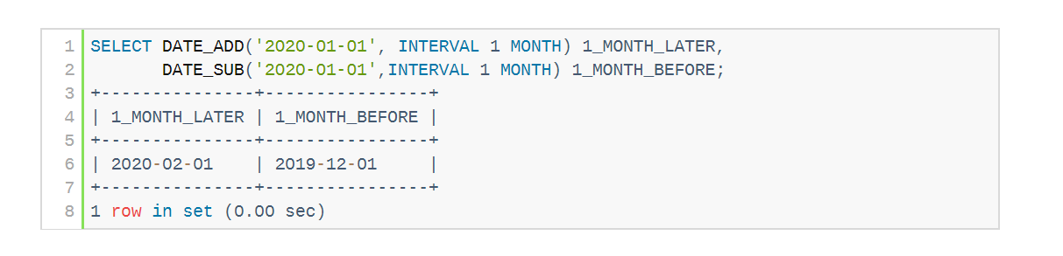
Built-in Data Types in SQL
date: Dates, containing a (4 digit) year, month and date
  Example: date ‘2005-07-27’
time: Time of day, in hours, minutes and seconds.
  Example: time ‘09:00:30’ time ‘09:00:30.75’
timestamp: date plus time of day
  Example: timestamp ‘2005-7-27 09:00:30.75’
interval: period of time
  Example: interval ‘1’ day
>>> details
Stores values in mentioned format only
Notes:
* If you don’t follow the format above, only 0’s will be stored

Slide 39
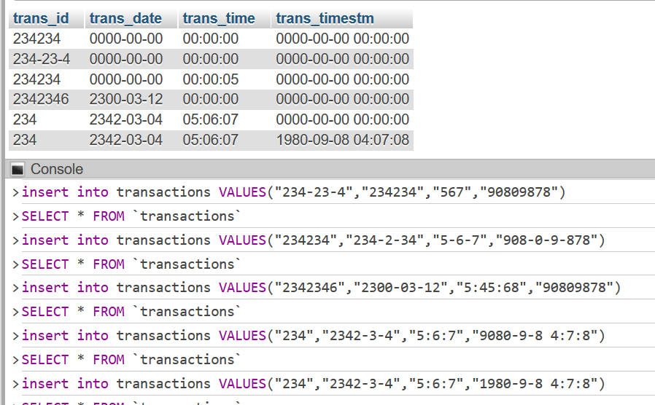
Example for Datatypes
create table transactions(
  trans_id char(30),
  trans_date date,
  trans_time time,
  trans_timestm timestamp );
Extract minutes of transactions for each day
use an expression of the form cast e as t to convert a character string
(or string valued expression) e to the type t, where t is one of date, time, or timestamp.
select extract(minute from trans_time) from transactions. Output?

Slide 40
Index Creation
create table student
(ID varchar (5),
name varchar (20) not null,
dept_name varchar (20),
tot_cred numeric (3,0) default 0,
primary key (ID))
create index studentID_index on student(ID)
Indices are data structures used to speed up access to records with specified values for index attributes
  e.g. select *
  from student
  where ID = ‘12345’
  can be executed by using the index to find the required record, without looking at all records of student
  More on indices in Chapter 11
Default value example:
insert into student(ID, name, dept name)
values (’12789’, ’Newman’, ’Comp. Sci.’);
Notes:
You must create an index on a particular attribute, such as id ex: create index studentID_index on student(ID)

Slide 41
User-Defined Types
create type construct in SQL creates user-defined type
  create type Dollars as numeric(12,2) final;
  create type Pounds as numeric(12,2) final;
  create table department
  (dept_name varchar (20),
  building varchar (15),
  budget Dollars);
Compare department’s budget of UK and USA?
(department.budget+20) generates error
Type cast might required: cast (department.budget to numeric(12,2))+20

Slide 42
Domains
create domain construct in SQL-92 creates user-defined domain types
  create domain person_name char(20) not null
Types and domains are similar. Domains can have constraints, such as not null, specified on them.
create domain degree_level varchar(10)
constraint degree_level_test
check (value in (’Bachelors’, ’Masters’, ’Doctorate’));
create domain YearlySalary numeric(8,2) constraint salary_value_test check(value >= 29000.00);

Slide 43

Large-Object Types
Large objects (photos, videos, CAD files, etc.) are stored as a large object:
  blob: binary large object -- object is a large collection of uninterpreted binary data (whose interpretation is left to an application outside of the database system)
  clob: character large object -- object is a large collection of character data – varchar(max) or Text in DBMS
  When a query returns a large object, a pointer is returned rather than the large object itself.
Example:
book review clob(10KB)/Text
image blob(10MB)
movie blob(2GB)
Binary Image: One bit per pixel

Slide 44
Example with Blob Type
* Create a table for profile picture
CREATE TABLE `university`.`profilePic` ( `ID` CHAR(5) NOT NULL , `photo` BLOB NOT NULL );
* Forgot to add primary key? Alter the table to add primary key constraints
ALTER TABLE `profilepic` ADD PRIMARY KEY( `ID`);
* Insert a profile picture from local file
INSERT into profilepic values("5687", LOAD_FILE('C:\\Users\\Amjad\\GoogleDriveKSU\\Rafia.JPG'))
Remember, BLOB is large Binary Object which is not human readable. So, You must ,
  convert input data to binary when inserting ( here LOAD_FILE does that)
  Convert binary to image/human understandable format when reading- you need to write your own function in you application.

Slide 45
Example of CLOB/Text
* Create a table to store information about Books
CREATE TABLE `university`.`books` ( `ISBN` CHAR(13) NOT NULL , `Title` VARCHAR(100) NOT NULL , `Authors` VARCHAR(200) NOT NULL , `Content` TEXT NOT NULL, PRIMARY Key(ISBN) )
* Insert a record in Books table. ( inserting directly from local text file)
INSERT INTO `books` (`ISBN`, `Title`, `Authors`, `Content`) VALUES ('458485858', 'Life of a Tree', 'Mr. Goat', LOAD_FILE('C:\\Users\\Amjad\\GoogleDriveKSU\\Code.txt'));
Text is human readable, so you can directly print or display it.

Slide 46
Data Control Language (DCL):
Authorization
Forms of authorization on parts of a database:
Read - allows reading, but not modification of data.
Insert - allows insertion of new data, but not modification of existing data.
Update - allows modification, but not deletion of data.
Delete - allows deletion of data.
Forms of authorization to modify the database schema (Structure)
Index - allows creation and deletion of indices.
Resources - allows creation of new relations.
Alteration - allows addition or deletion of attributes in a relation.
Drop - allows deletion of relations.

Slide 47
Authorization Specification in SQL
The grant statement is used to confer authorization
grant <privilege list>
on <relation name or view name> to <user list>
<user list> is:
  a user-id
  public, which allows all valid users the privilege granted
  A role (more on this later) – category of users
Granting a privilege on a view does not imply granting any privileges on the underlying relations.
The grantor of the privilege must already hold the privilege on the specified item (or be the database administrator).
Notes:
* Syntax of granting certain privileges to certain users

Slide 48
Privileges in SQL
select: allows read access to relation,or the ability to query using the view
  Example: grant users U₁, U₂, and U₃ select authorization on the instructor relation:
grant select on instructor to U₁, U₂, U₃
insert: the ability to insert tuples
update: the ability to update using the SQL update statement
delete: the ability to delete tuples.
all privileges: used as a short form for all the allowable privileges // use the * for all privileges
grant update (budget) on department to John, Tom;

Slide 49
Revoking Authorization in SQL
The revoke statement is used to revoke authorization.
  revoke <privilege list>
  on <relation name or view name> from <revokee-list>
Example:
  revoke select on branch from U₁, U₂, U₃
<privilege-list> may be all to revoke all privileges the revokee may hold.
If <revokee-list> includes public, all users lose the privilege except those granted it explicitly.
If the same privilege was granted twice to the same user by different grantees, the user may retain the privilege after the revocation.
All privileges that depend on the privilege being revoked are also revoked.

Slide 50
Roles
Organizational position-used to categorize users.
create role instructor;
grant instructor to Amit;
Privileges can be granted to roles:
  grant select on takes to instructor;
Roles can be granted to users, as well as to other roles
  create role teaching_assistant
  grant teaching_assistant to instructor;
    Instructor inherits all privileges of teaching_assistant
Chain of roles
  create role dean;
  grant instructor to dean;
  grant dean to Satoshi;
Satoshi
Amit
dean
instructor
select
takes
teaching_assistant
Can access
students,
course

Slide 51
Authorization on Views
create view geo_instructor as
(select *
from instructor
where dept_name = ’Geology’);
grant select on geo_instructor to geo_staff
Suppose that a geo_staff member issues
  select *
  from geo_instructor;
What if
  geo_staff does not have permissions on instructor?
  creator of view did not have some permissions on instructor?

Slide 52
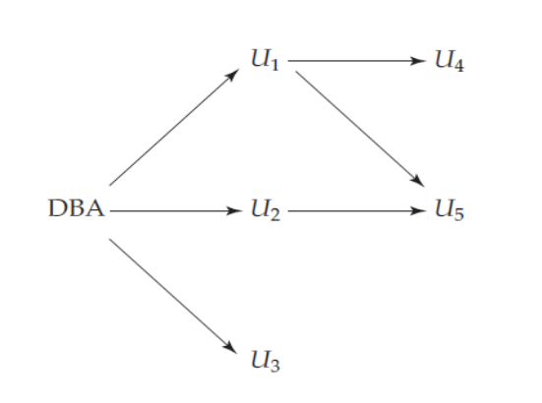
Other Authorization Features
references privilege to create foreign key
  grant reference (dept_name) on department to Mariano;
  why is this required?
transfer of privileges
  grant select on department to Amit with grant option; - can pass grant to others
  revoke select on department from Amit, Satoshi cascade; - cascading is the default behavior. Can be avoided by restrict
  revoke select on department from Amit, Satoshi restrict;
Etc. read Section 4.6 for more details
Authorization Grant Graph: -
User must have path to DBA

Slide 53
End of Chapter 4

Slide 54

Figure 4.01

Slide 55

Figure 4.02

Slide 56

Figure 4.03

Slide 57

Figure 4.04

Slide 58

Figure 4.05

Slide 59

Figure 4.07
Taylor

Slide 60

Figure 4.06

Slide 61

Figure 4.03

